Slide 1


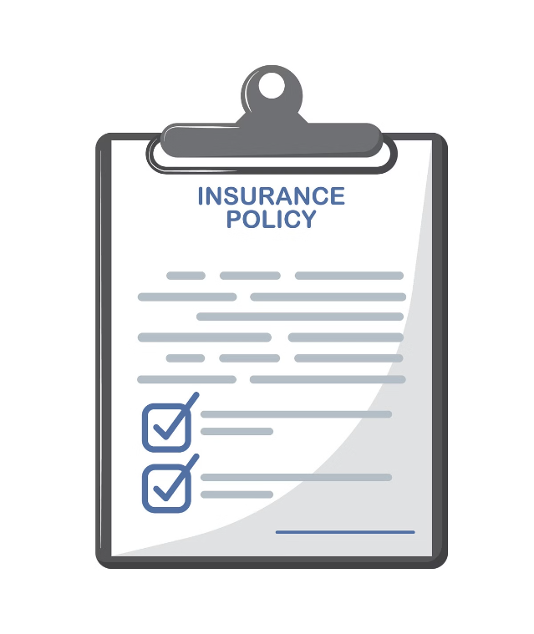
Insights to Grow Shield Insurance
Analyzing Shield Insurance's data reveals key trends in revenue, customer demographics, and settlement patterns to guide strategic decisions for growth.

Slide 2
Overview of Dashboards
General Overview
Sales Performance Analysis
Age Demographic Analysis
General view analysis provides a high-level summary of key metrics and trends through interactive visualizations, offering insights for data-driven decision-making.
A Sales Analysis view in Power BI offers a detailed overview of sales performance, highlighting trends, revenue breakdowns, and key metrics to drive strategic decisions.
An Age Group Analysis in Power BI segments data by age brackets, revealing demographic trends, customer behavior, and preferences to inform targeted strategies

Slide 3
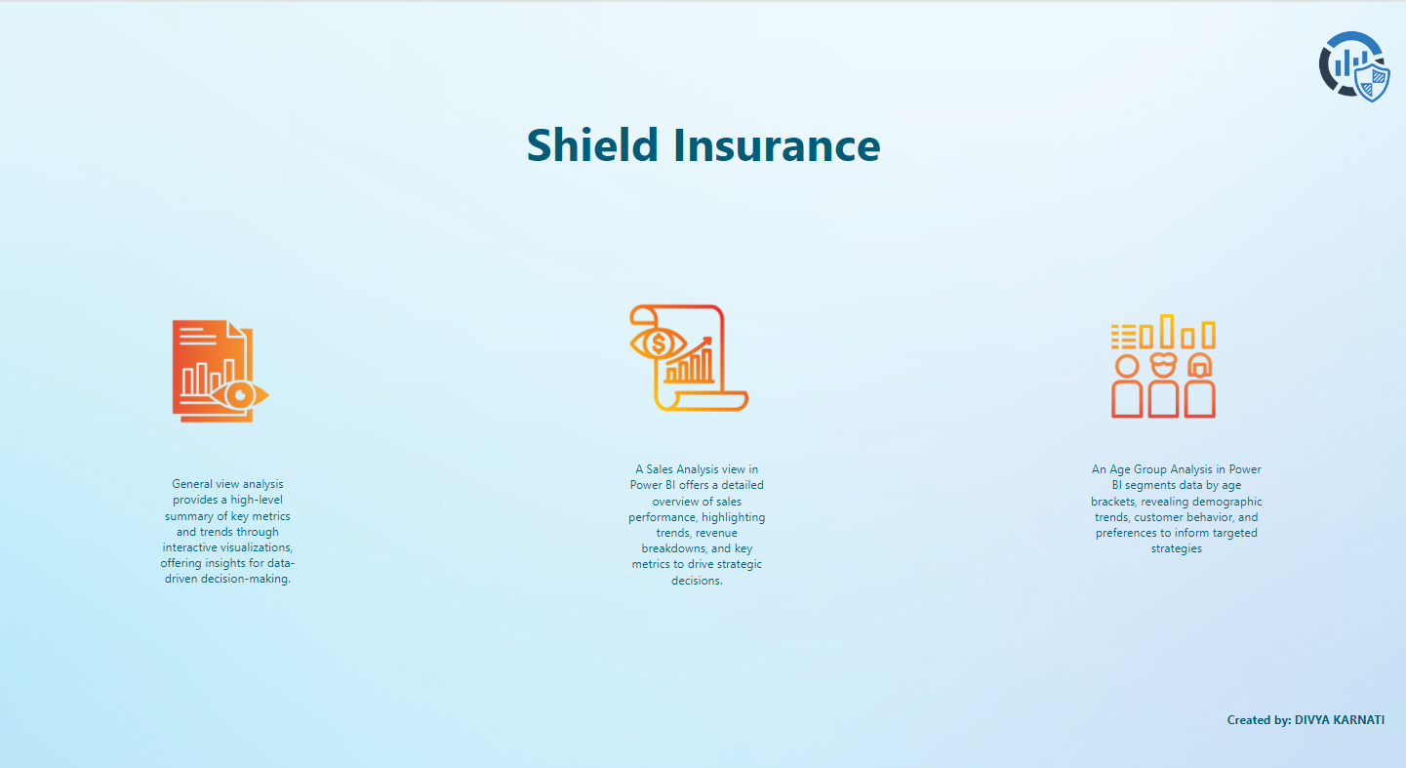

Slide 4
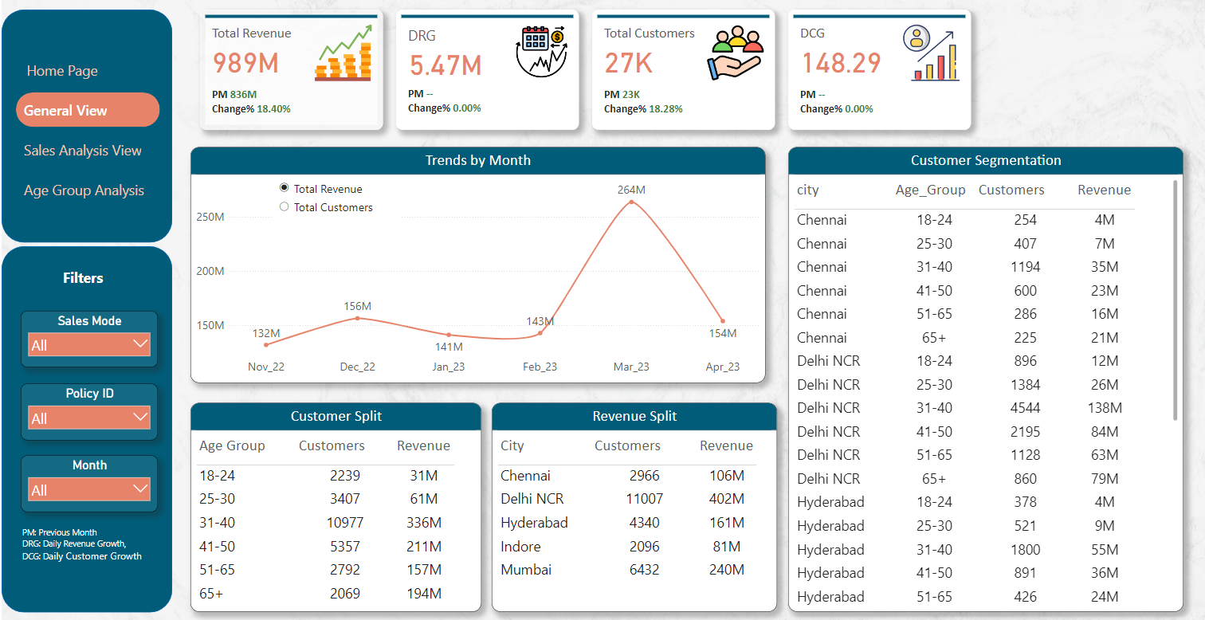

Slide 5
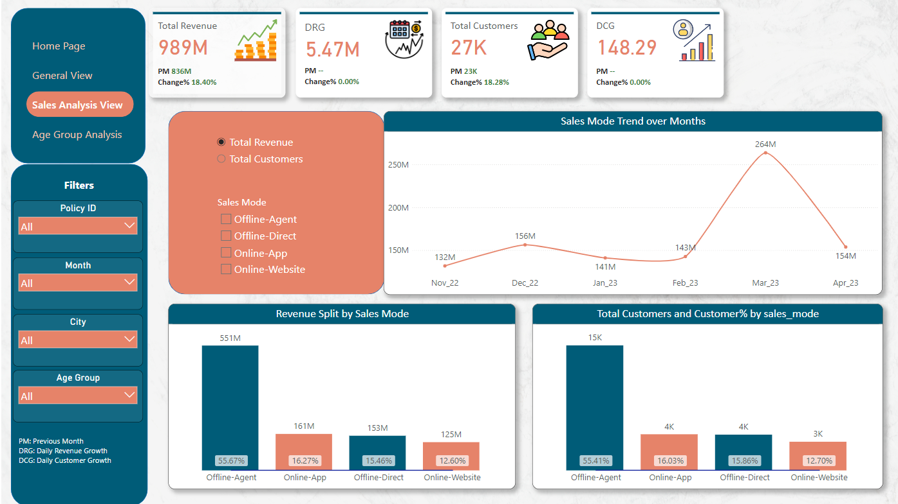

Slide 6
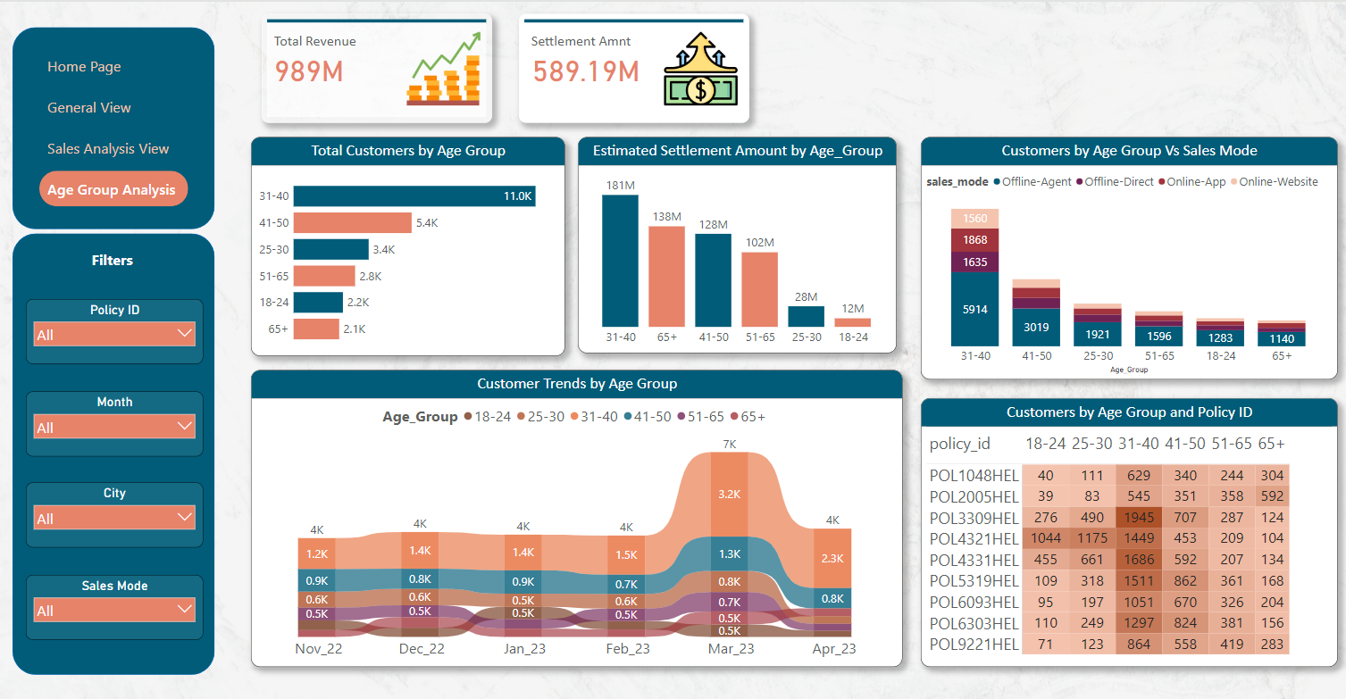

Slide 7


Revenue Trends
1
March 2023
Highest revenue within the analyzed period.
2
November 2022 - April 2023
Steady daily revenue growth of ₹5.47 Million.
3
Total Revenue
₹989 Million

Slide 8
Customer Demographics
Age Group
Geographic Insights
Sales Mode
31-40 has the highest number of customers and generates the most revenue.
Delhi NCR, Mumbai, and Hyderabad have the highest number of customers and revenue.
Offline agent sales generate the highest revenue and have the most customers.

Slide 9


Settlement Insights
Settlement Amount
₹589.19 Million
Age Group
The 31-40 age group has the highest estimated settlement amount.
Risk Management
Implement strategies to minimize claims and optimize the settlement process.

Slide 10
Targeted Marketing
1
Focus on 31-40 Age Group
2
Target Key Regions
3
Enhance Offline Agents
Delhi NCR, Mumbai, and Hyderabad have the greatest potential for growth.
This segment has the highest number of customers and revenue contribution.
The offline agent network is the most effective sales channel.

Slide 11



Sales Strategy
Agent Training
Agent Incentives
Sales Support
Invest in training programs to boost agent performance.
Implement incentive schemes to motivate the offline agent network.
Provide comprehensive support to the offline agent channel.

Slide 12



Settlement Management
Monitor Settlements
Assess Risks
Optimize Process
Closely track the settlement process for the 31-40 age group.
Implement risk assessment strategies to minimize claims.
Streamline the settlement process to improve efficiency.

Slide 13


Revenue Optimization
Investigate Revenue Peak
Understand the reasons behind the March 2023 revenue spike.
Replicate Strategies
Implement successful strategies from the peak period across other months.
Continuous Improvement
Regularly analyze and optimize revenue-driving initiatives.

